Slide 1
Web Programming Language
Week 8
Asynchronous Javascript & API

Slide 2
Asynchronous Javascript & API
History of AJAX
Jquery & AJAX
Promises
Thenables
Fetch API
Async / Await
API

Slide 3
AJAX
Asynchronous JavaScript and XML
used for making asynchronous web applications, which means that different parts of the page can be loaded at different times
Don’t forget, our webpages are loaded from a server!

Slide 4
Looking back in History
Early websites loaded a new HTML file when a page was requested
But why not just update part of the page
Heard of Frames?
Frames were used to break a page down into sections, and each frame could load a different HTML file.
But, search engines found it difficult to index pages.
Different devices responded differently to frames.
The Back button didn’t always work as expected.
There is a better way!

Slide 5
AJAX
Allows the browser to communicate with the server, by letting JavaScript use the XMLHttpRequest object to request data from the server.
When an event occurs, JavaScript can create an instance of the XMLHttpRequest object, send it to the server, which sends a response in XML, or more commonly now JSON.

Slide 6
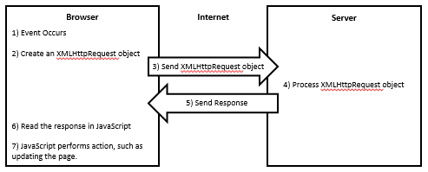
AJAX Call

Slide 7
Classic AJAX
<html> <body> <p id="demo" onclick="UpdateContent()">Original Page Content.</p> <script> function UpdateContent() { var xhttp = new XMLHttpRequest(); xhttp.onreadystatechange = function() { if (this.readyState == 4 && this.status == 200) { document.getElementById("demo").innerHTML = this.responseText; } }; xhttp.open("GET", "newdata.txt", true); xhttp.send(); } </script> </body> </html>

Slide 8
ReadyState?
0 | Request not initialized
1 | Server connection established
2 | Request received
3 | Processing request
4 | Request finished and response is ready

Slide 9
UGH!
There must be a better way!

Slide 10
JQuery and AJAX
JQuery offers a few methods to support AJAX requests
The load() method
$(“#div1”).load(“data.txt”);
This would load the contents of a text file into div1.
$(“#div1”).load(“data.htm #news”);
This would load a section of an html file into div1.
Any file could be loaded.

Slide 11
$.get() method
The get() method uses a callback function to be executed after data is returned from the server using the GET method.
$(“#p1”).click(function(){ $.get(“data.txt”, function(data, status){ console.log(data + “: status : “ + status ); }); });

Slide 12
$.post() method
The post() method posts data to the server using the post method
$(“#p1”).click(function(){ $.post(“add_student.php”, { name: “Ken”, id: “1234” }, function(data, status){ console.log(data + “: status : “ + status ); }); });
The data here could then be added to a database using a script in add_student.php

Slide 13
$.ajax() method
If $.post() and $.get() aren’t enough, Jquery also has a $.ajax() method.
$(“#p1”).click(function(){ $.ajax({ url:“add_student.php”, data: { name: “Ken”, id: “1234” }, method: POST }) .done(function(html){ console.log(html); }); });

Slide 14
The problem?
Remember the callbacks for animations?
Handling Errors
Scalability
Nested Callbacks
AKA Callback Hell!
function1(parameters, function() { //do something function2(parameters, function() { //do something function3(parameters, function() { //do something }); }); });

Slide 15
But…
There must be a better way!

Slide 16
Promises
A Proxy for a value not known when the promise is created depending on the completion (or failure) of an asynchronous operation and it’s resulting value.
Can have 3 states
Pending
Fulfilled
Rejected

Slide 17
My Promise
What do you think this returns to the console?
const myPromise = new Promise((resolve, reject) => {
const err = false;
if(!err) {
resolve("Success!");
}
else {
reject("Fail!");
}
});
console.log(myPromise);

Slide 18
My Promise
Not quite “Success!”

Slide 19
Thenables
To get the value from the promise, we need to chain.
We could use a Thenable to chain.
myPromise.then(value => {
console.log(value);
})

Slide 20
Thenables
We could then chain Thenables to pass that result to a new function…
But… There must be a better way…
(N.B. I’m not dealing with an error here) - .catch().

Slide 21
Fetch API
The Fetch API allows us to fetch resources across a network.
More powerful / flexible than XMLHttpRequest
It takes 1 parameter – the resource you want to fetch
It returns a promise

Slide 22
Fetch API
We could fetch some appointments from my calendar’s simple API
fetch("http://www.kencosh.com/calendar/calendar.php")
.then(response => {
return response.json();
})
.then(data=> {
data.forEach(date => {
console.log(date);
})
})

Slide 23
Thenables?
This approach may not be as bad as callbacks, but we still end up with a chain of thenables…
There must be a better way?

Slide 24
Async / Await
There is a better way;
const getdata = async () => {
const response = await fetch("http://www.kencosh.com/calendar/calendar.php");
const jsondates = await response.json();
console.log(jsondates);
}
getdata();

Slide 25
The API?
Server side code
Database that stores calendar data
Some code to return data requests

Slide 26
MySQL
Databases are a great way of managing data!
Just imagine saving calendar appointments in a file, and then searching that file to find which appointments you need to display!
MySQL is a database server that scales for small and large applications using SQL (Structured Query Language) to interact with it.
Data is stored in tables – tables store data about entities
Tables consist of rows and columns, (like spreadsheets)
Tables can be related to each other
In other courses you will learn about databases in depth, here we will look briefly at key operations.

Slide 27

PHPmyadmin
A GUI (Graphical User Interface) allowing easy database creation and manipulation.

Slide 28
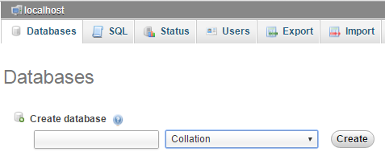
Create a Database

Slide 29
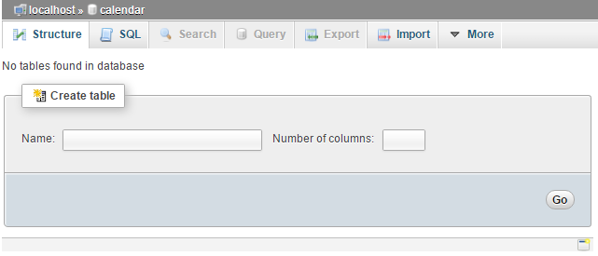
Create a Table

Slide 30
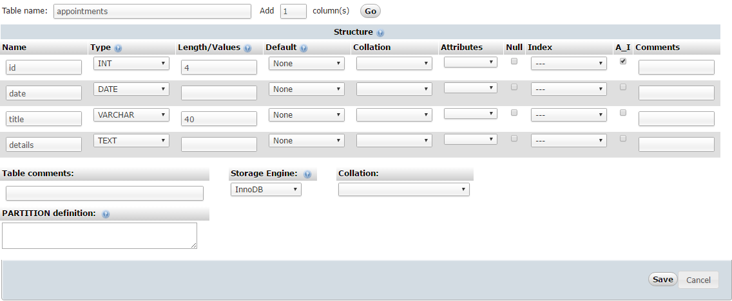
Set up the columns
To store appointments, you might want an id, a date, a title, and details.
Auto Increment
Integer
Variable Character
Text (Stored
Separately)

Slide 31
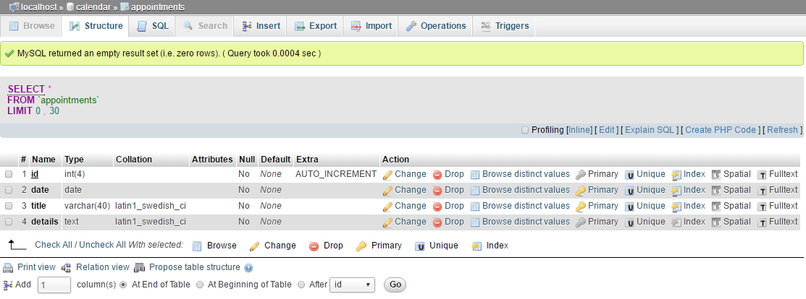
Check the Structure

Slide 32
Structured Query Language (SQL)
Database language used by a variety of databases
SELECT – for retrieving data from the database
SELECT * FROM appointments LIMIT 0 , 30;
The general syntax of a SELECT statement is as follows.
SELECT column_name1, column_name2 FROM table_name;
A WHERE clause can be added for more precise results.
SELECT * FROM appointments WHERE id=1;

Slide 33
SQL - INSERT
Basic Syntax
INSERT INTO table_name VALUES (value1, value2,…);
Specifying which columns
INSERT INTO table_name (column1, column2,…) VALUES (value1, value2,…);
Example
INSERT INTO appointments (date, title, details) VALUES ("2016-08-05", "Meeting", "All day in room 401");

Slide 34
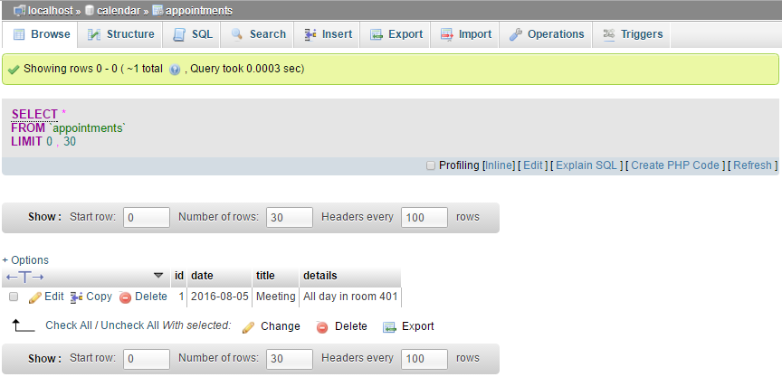
SQL INSERT

Slide 35
SQL UPDATE
Basic Syntax
UPDATE table_name SET column1=value1, column2=value2 WHERE column=value;
Example
UPDATE appointments SET details="Meet at 9AM" WHERE id = 1;

Slide 36
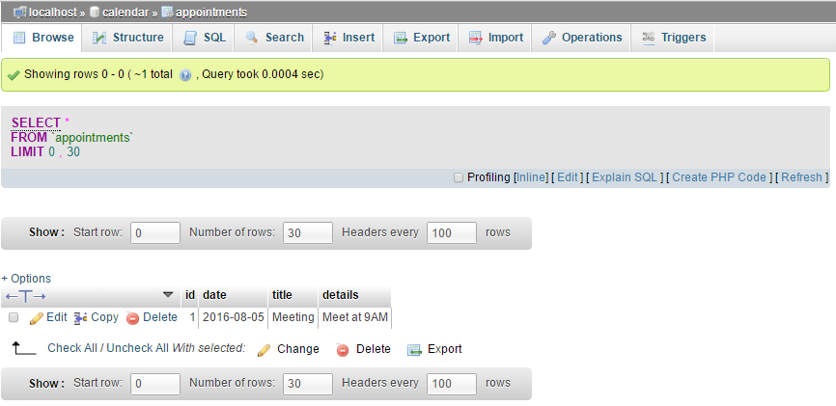
SQL UPDATE

Slide 37
SQL DELETE
Basic Syntax
DELETE FROM table_name WHERE column_name = value;
Example
DELETE FROM appointments WHERE date = "2016-08-05";

Slide 38
MySQLi
MySQLi (the i is for ‘improved’) is an API for manipulating a MySQL database using PHP.
Be careful to use MySQLi, NOT MySQL!
There are alternative to MySQLi, but we will stick with MySQLi
MySQLi offers either a procedural approach, or an object oriented approach.
We will explore both – it is your choice which to use – perhaps the OO option?

Slide 39
Connecting to the Database
Procedural
$link = mysqli_connect(“localhost",“username",“password",“databasename") or die("Error" . mysqli_error($link)); //Some Code mysqli_close($link);
OO
$mysqli = new mysqli("localhost", “username", "password", “databasename"); // Some Code $mysqli->close();
Worth moving the connection script to a separate file
Include “database.php”

Slide 40
Querying a Database
Create a variable that stores the query
$qry1 = “CREATE DATABASE calendar”; $qry2 = "CREATE TABLE users ( FirstName varchar(15), LastName varchar(15) )”; $qry3 = “INSERT INTO appointments (date, title, details) VALUES (‘2016-08-06’, ‘Exam’, ‘9AM’)”;
Use mysqli to call the query
mysqli_query($link, $qry1); //procedural approach $mysqli->query($qry3); // OO approach

Slide 41
Tip
If you have a mistake in your SQL, you may get no response, and no error.
Use the SQL option in phpMyAdmin to check and fix an error.

Slide 42
PHP and SELECT
The SELECT statement returns some results – we could check how many…
Procedural
$link = mysqli_connect(“localhost",“username",“password",“databasename"); $qry = “SELECT * FROM appointments”; if ($result = mysqli_query($link, $qry)) { echo “There are “ . mysqli_num_rows($result) . “ rows!”; mysqli_free_result($result); } mysqli_close($link);
OO
$mysqli = new mysqli("localhost", “username", "password", “databasename"); $qry = “SELECT * FROM appointments”; if ($result = $mysqli->query($qry)) { echo “There are “ . $result->num_rows . “ rows”; $result->close(); } $mysqli->close();

Slide 43
PHP and SELECT
The results are stored in a data object, and they can retrieved in different formats.
As an array
$qry = “SELECT * FROM appointments”; $result = $mysqli->query($qry); while($row = $result->fetch_array()) { print_r($row); }

Slide 44
PHP and SELECT
As an associative array
$qry = “SELECT * FROM appointments”; $result = $mysqli->query($qry); while($row = $result->fetch_assoc()) { print_r($row); }

Slide 45
PHP and SELECT
As an object
$qry = “SELECT * FROM appointments”; $result = $mysqli->query($qry); while($row = $result->fetch_object()) { print_r($row); }

Slide 46
PHP API
Let’s look briefly at the code to return calendar dates…

Slide 47
Key Points
How to deal with Asynchronous events
The Fetch API & Async / Await
APIs

Slide 48
Lab Challenge
Use the API to generate your calendar view!

